Slide 1


<Insert Picture Here>
8 Mapviewer

Slide 2
Topics
MapViewer Architecture
Installing, Configuring and Managing
Defining Maps
Developing Applications
Other Tools
Resources

Slide 3
What is MapViewer ?
A standard feature of all versions of Fusion Middleware
Map definitions and symbology stored in the database
Map builder GUI
Thematic mapping
High performance map cache
Integration in Business Intelligence tools and many applications
Multiple content sources
Local (Oracle database)
Online web services
Hybrid (local database + online content)
Multiple development options
JavaScript for rich user interfaces
Java, JSP and XML APIs
ADF component, APEX integration
Multiple devices
Web browsers
Tablets and smartphones

Slide 4
MapViewer Architecture: Oracle Maps
Client
(browser)
Application
JavaScript Map API
HTTP
Application Server
Tile Cache
Tile Cache Server
Data Server
Map Rendering Engine
JDBC
Database
Spatial
Tables
Map
Definitions
Mapbuilder

Slide 5
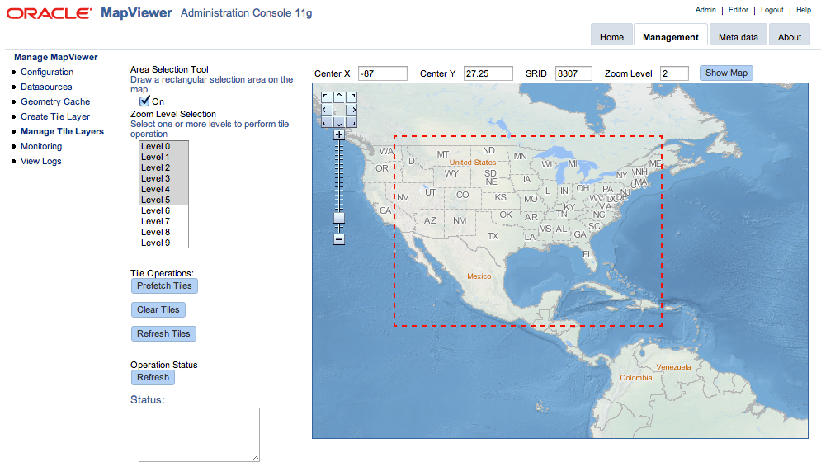
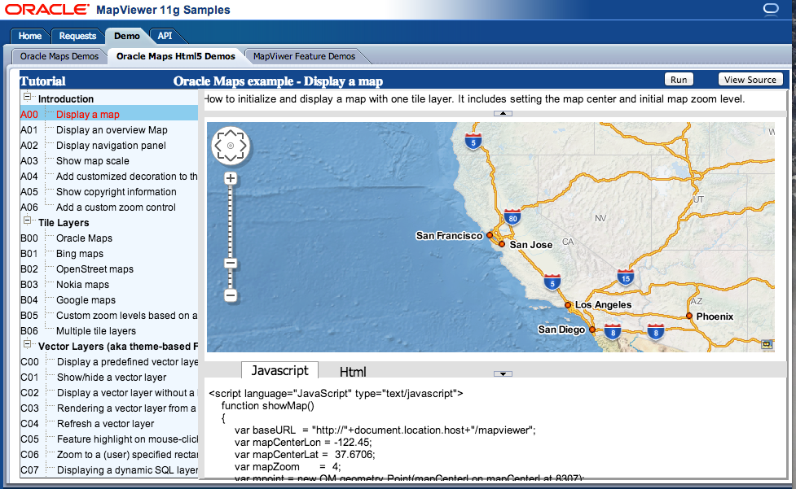
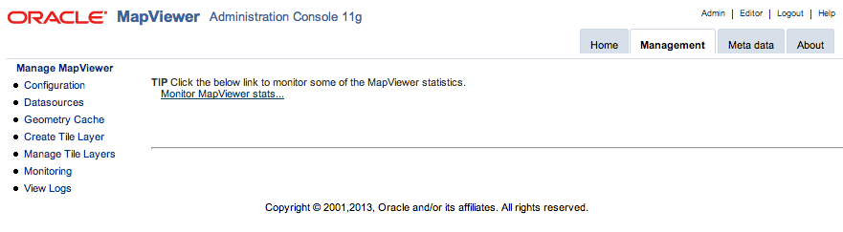
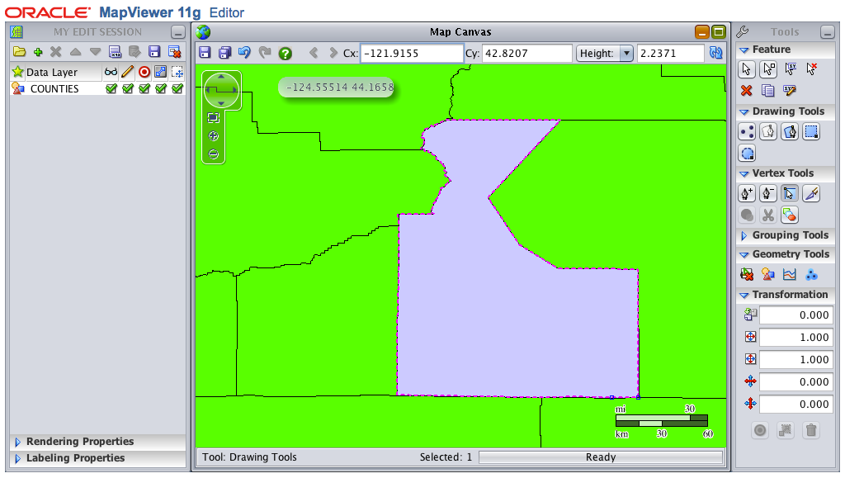
Latest Version
Mapviewer 12cR2 (12.2.1)
Rich client interactivity
HTML5-based API
Map data editing
3rd party data sources
New admin console
Separate MVDEMO samples
Glassfish-based “quick start” kit

Slide 6
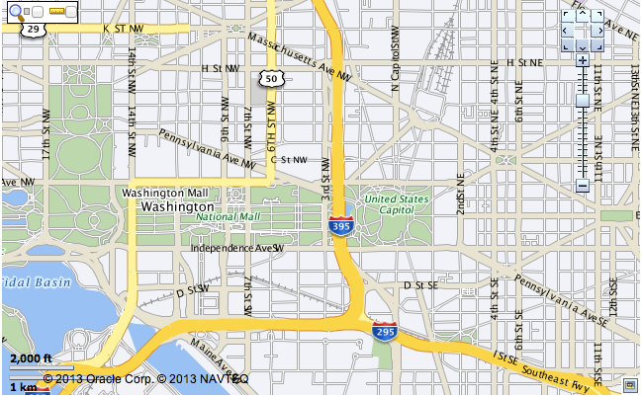
Installing and Configuring

Slide 7
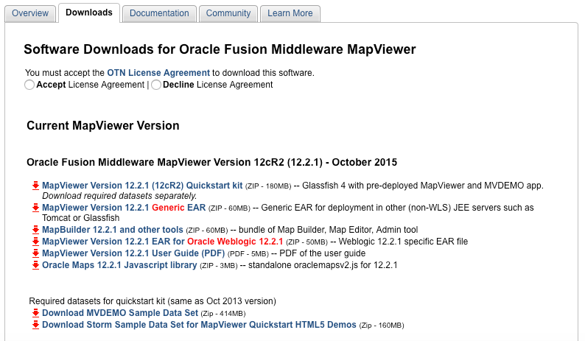
Downloading MapViewer
“Quick Start” Kit
With Glassfish server
Installation Kit for JEE servers other than Weblogic
Map Builder
Installation Kit for Weblogic
Manual
http://www.oracle.com/technetwork/middleware/mapviewer/downloads/index.html

Slide 8
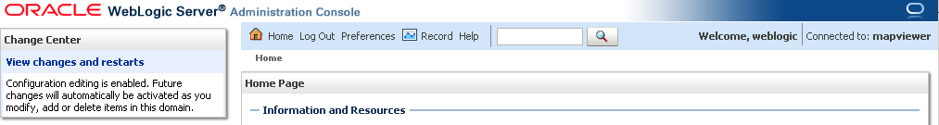
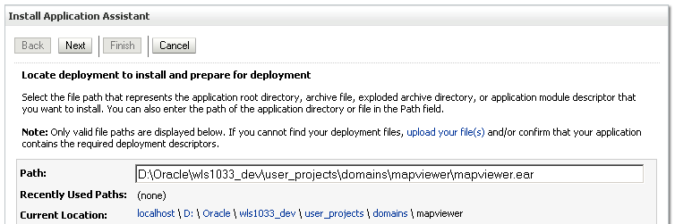
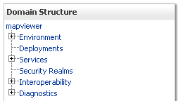
Installing MapViewer
Deploy the application (mapviewer.ear) into your application server
No longer need to manually unpack the ear file (Weblogic)

Slide 9
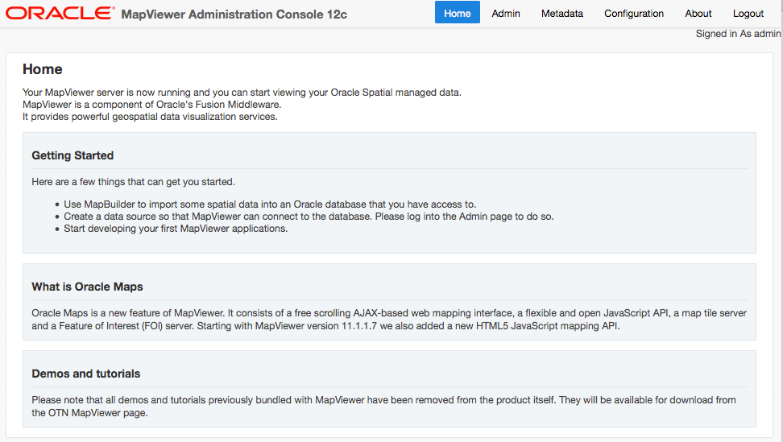
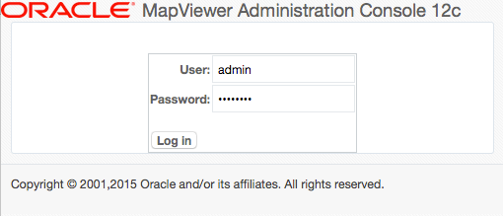
MapViewer Administration Console
http://<server>/mapviewer
http://<server>/mapviewer

Slide 10
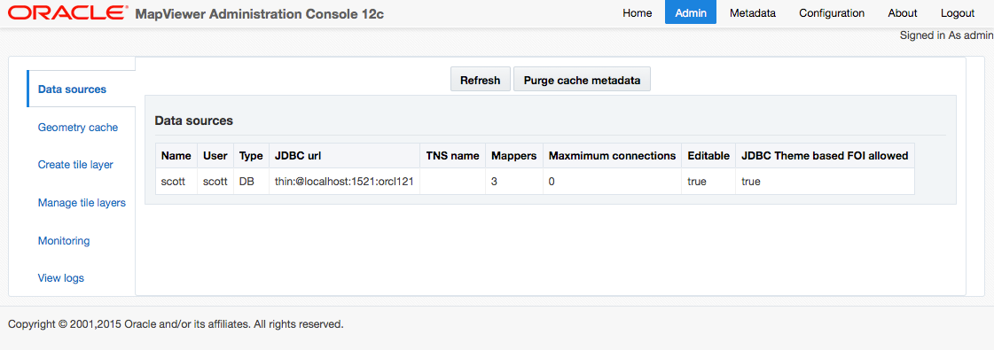
MapViewer Administration Console
Manage data sources
Manage Tile Layers
Monitor
View logs

Slide 11
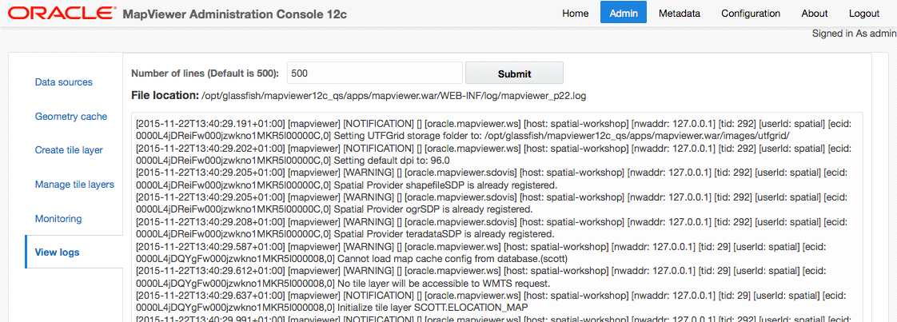
Viewing the current log

Slide 12
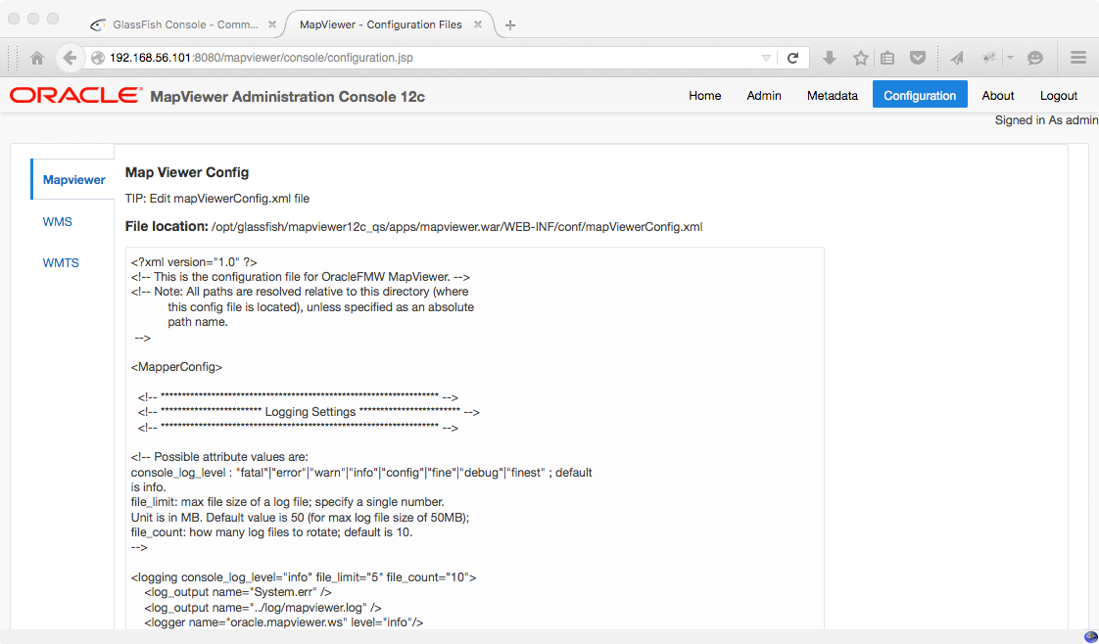
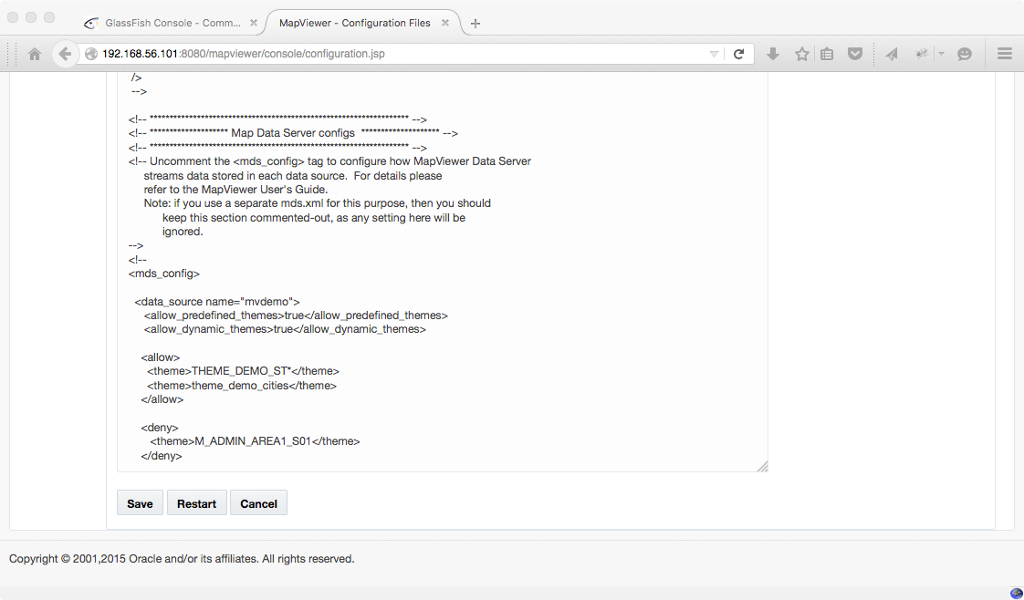
Updating the Configuration
http://<server>/mapviewer

Slide 13
Set Logging and Tracing
Logging level
Log destinations
Log level “finest” good for debugging
Will show each and every request and response
Will show each SQL statement
<logging log_level="finest" log_thread_name="true"
log_time="true">
<log_output name="System.err" />
<log_output name="../log/mapviewer.log" />
</logging>

Slide 14
Define a Data Source
Specify JDBC connection parameters
Host, port, service
Username and password
Database connection.
Use “//<service_name” to indicate connection to a service (for example a PDB in a multi-tenant environment)
<map_data_source name="scott_ds"
jdbc_host="127.0.0.1"
jdbc_port="1521"
jdbc_sid="//orcl121"
jdbc_user="scott"
jdbc_password="!tiger"
jdbc_mode="thin"
max_connections="5"
number_of_mappers="3"
allow_jdbc_theme_based_foi="true"
/>
Username and password
Password must be preceded with “!”. Will be encrypted in the file.

Slide 15
Define a Data Source
Can also use a container-managed data source
<map_data_source name="scott_ds"
container_ds="jdbc/scottDS"
max_connections="5"
number_of_mappers="3"
allow_jdbc_theme_based_foi="true"
/>

Slide 16
Set Security
Disable direct information requests
Those are XML requests that let you query any table accessible via any data source
Enabled by default!
<security_config>
<disable_direct_info_request> true </disable_direct_info_request>
...
</security_config>

Slide 17
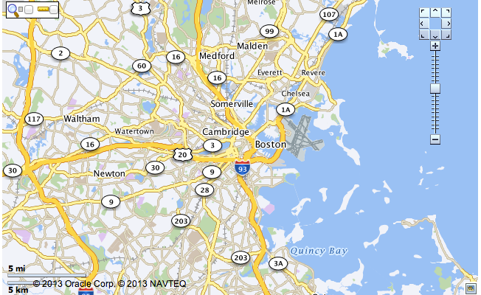
Defining Maps

Slide 18
Defining Maps
Styles: define how shapes should be rendered
Areas: color, transparency, boundary thickness and color, …
Lines: color, thickness, center lines, wing lines, hash marks
Points: symbols, graphics, …
Texts: font, styling, color, size, halo, …
Themes: associate a spatial table and a style
Graphic style and text style (for labels)
Maps: group a number of themes
Visibility of themes based on scale
Tile Layers: make a base map available to web applications
Styles
Spatial Tables
Themes
Maps
Tile Layer

Slide 19
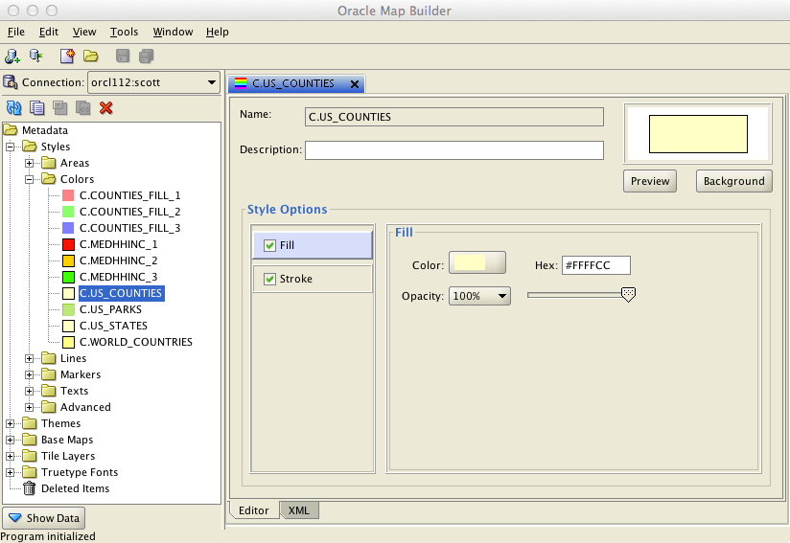
Defining a Color Style

Slide 20
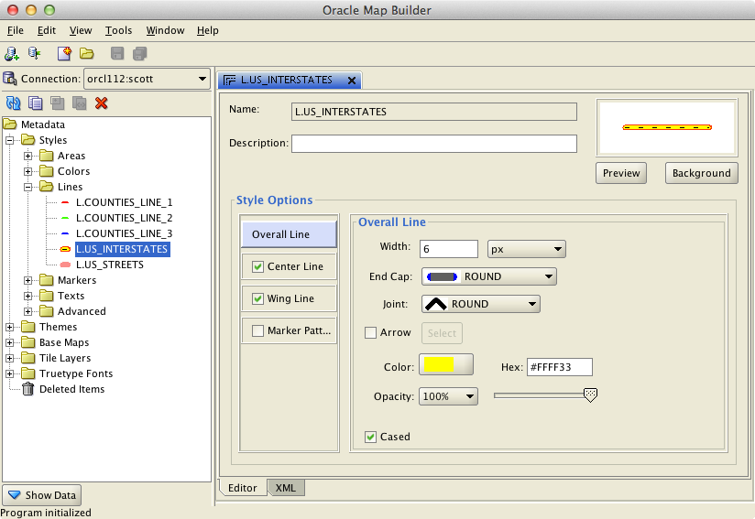
Defining a Line Style

Slide 21
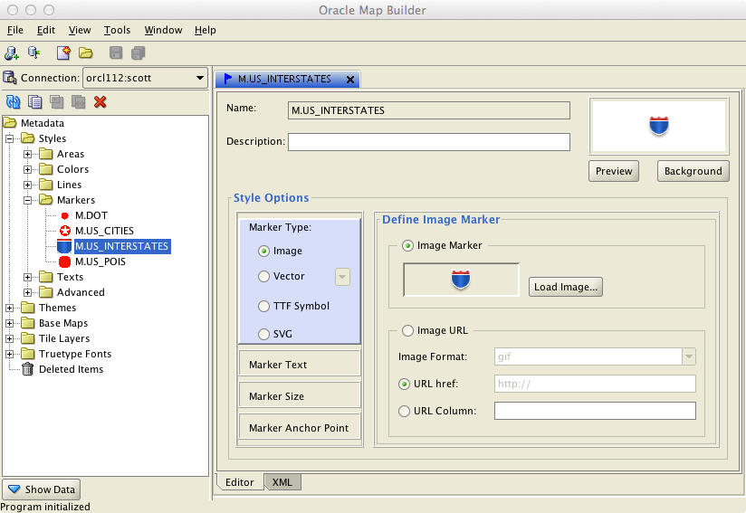
Defining a Marker Style

Slide 22
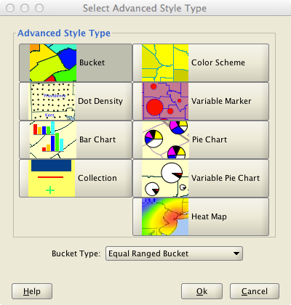
Thematics: Advanced Styles
Bucket
Specify variable or fixed (equal-range) buckets
Separate color for each bucket
Color Scheme
Variable or fixed buckets
Buckets assigned gradually darker colors from a base color
Dot Density
Area filled with dots proportionally to the value of the variable
Variable Marker
Size of chosen symbol increases proportionally to the value of the variable

Slide 23
Thematics: Advanced Styles
Bar Chart
Combines multiple variables
Pie Chart
Same
Variable Pie Chart
Same, but size of pie chart increases proportionally to the sum of the variables
Heat Map
Color ranges from “cool’ (blue) to “hot” (red) according to density of geometries

Slide 24
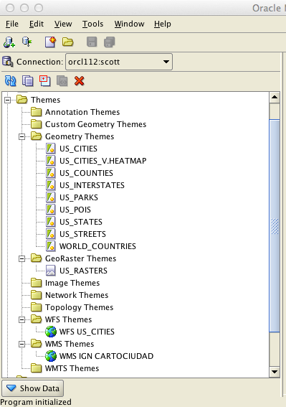
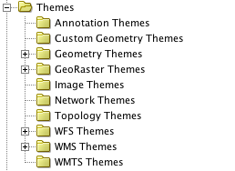
Defining Themes

Slide 25
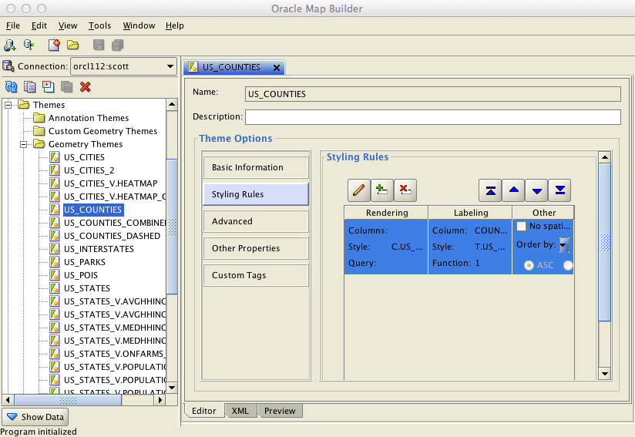
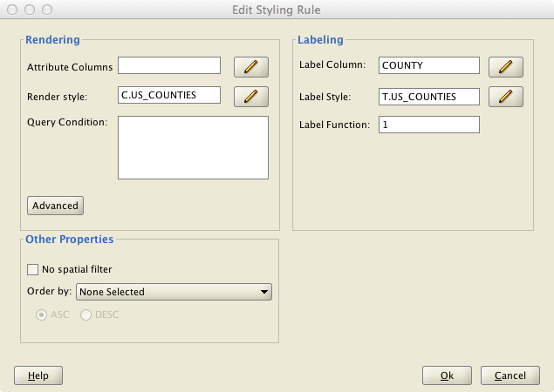
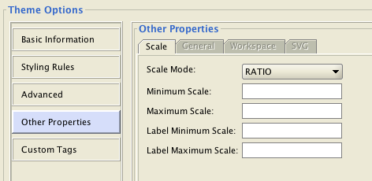
Defining a Geometry Theme

Slide 26
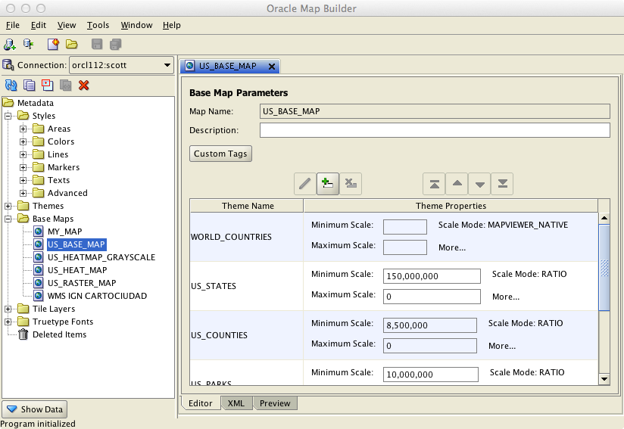
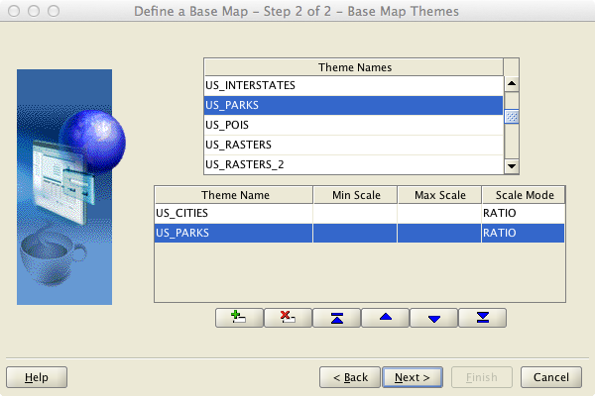
Defining a Map

Slide 27
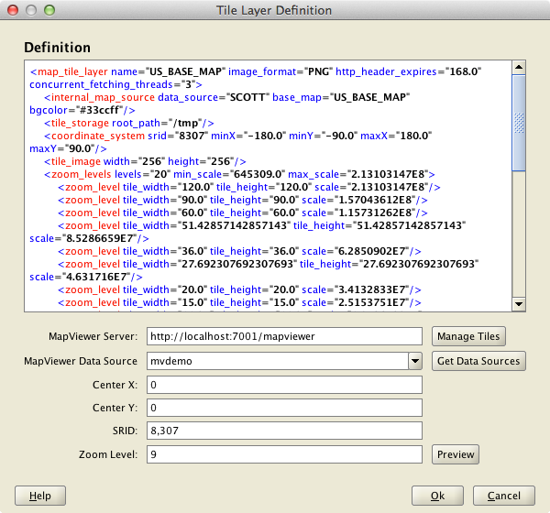
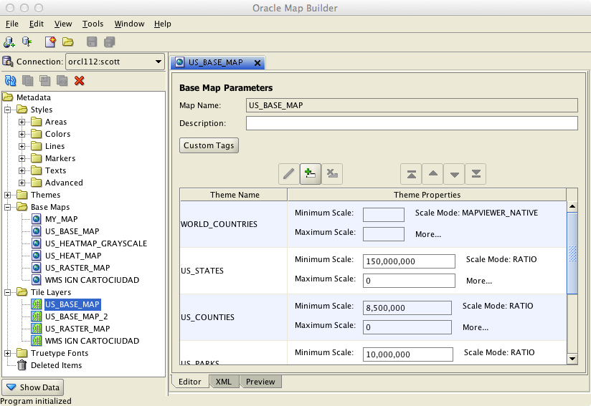
Define a Tile Layer
Use the Tile Layer definition wizard
Select base map
Select area from the map
Select min and max scales from the map
Generate scales for zoom levels
Choose tile size
Preview

Slide 28
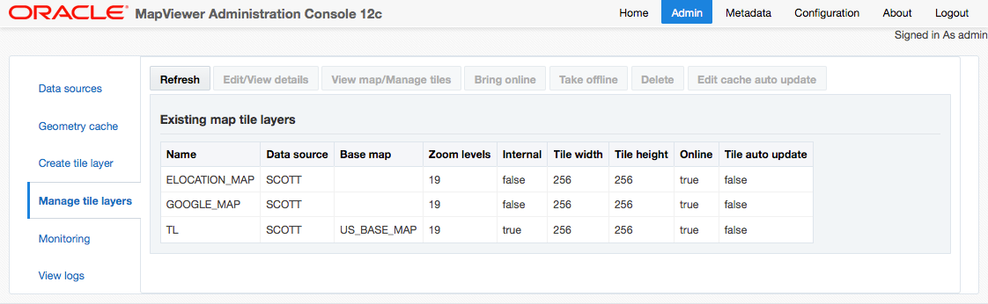
Manage Tile Layers

Slide 29
Manage Tile Layers

Slide 30
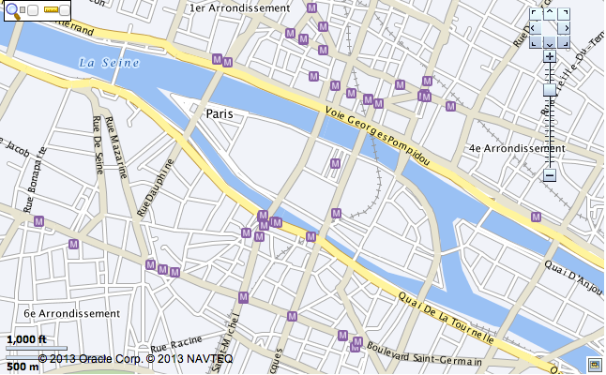
Developing Applications

Slide 31
Mapping Applications
JavaScript APIs
Oracle Maps API V1
Oracle Maps API V2 (since version 11.1.1.7)
Complete re-write of the Oracle Maps JavaScript API
Based on HTML5 (canvas & svg) standards
Much richer client-side rendering & interaction
Mobile support
Supports lightweight data editing and region management

Slide 32
Examples and Tutorials
“MVDEMO” Application
Download and install “MVDEMO” application and associated data sets
Quick Start kit has the application pre-installed
Just need to download and import the sample data sets
“Quick Start” Kit
With Glassfish server, Mapviewer and examples
Sample Data Sets

Slide 33
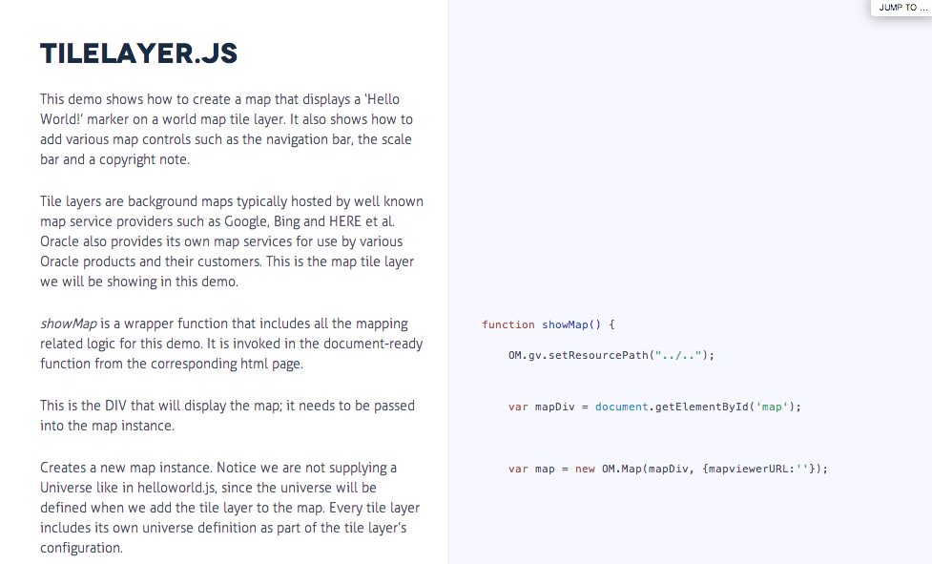
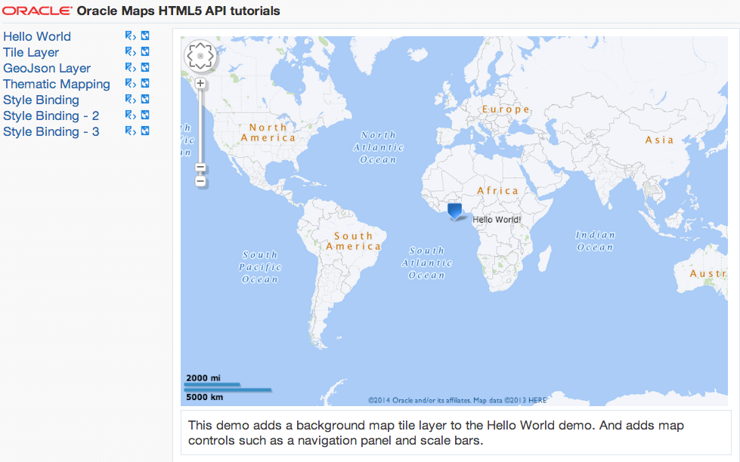
Online Tutorials
http://slc02okf.oracle.com/

Slide 34
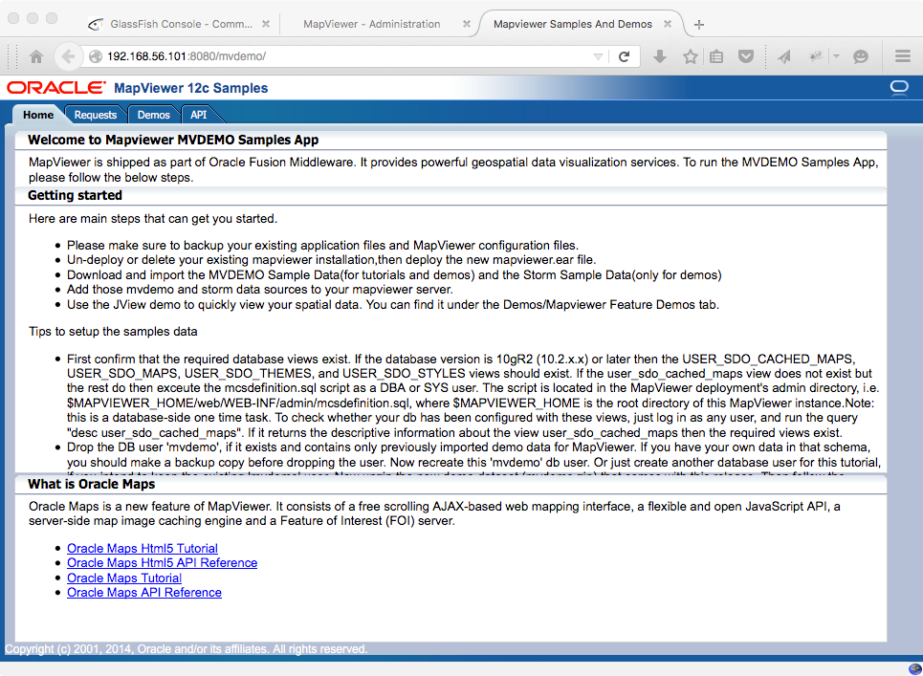
Examples and Tutorials
http://<server>/mvdemo
Online at
http://slc02okf.oracle.com/mvdemo

Slide 35
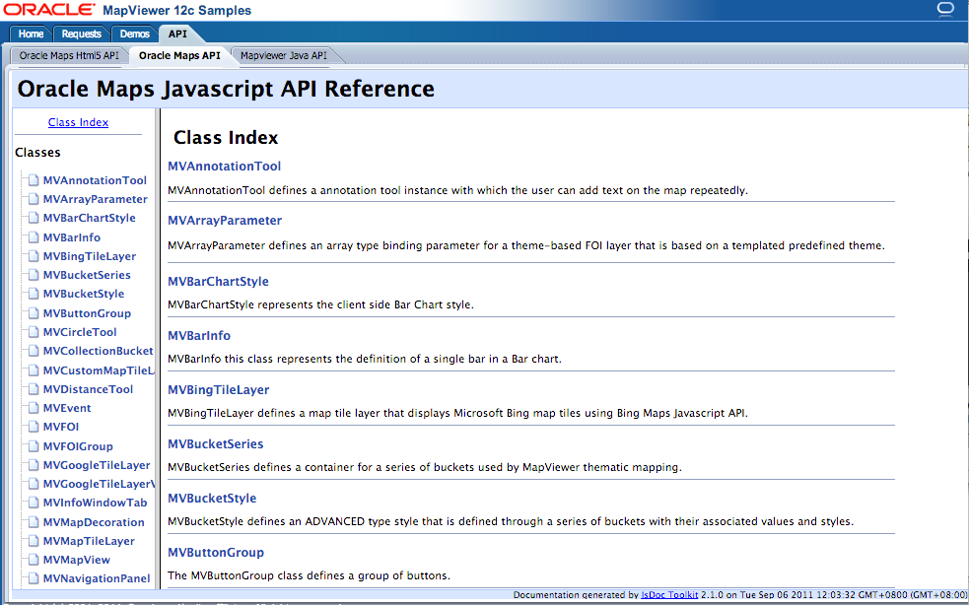
Oracle Maps V1 API Documentation

Slide 36
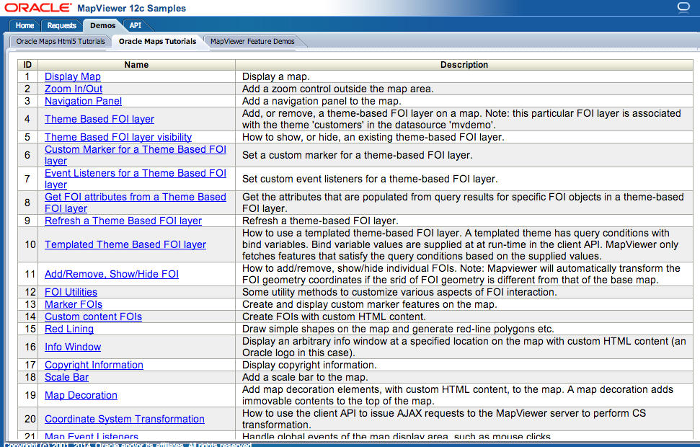
Oracle Maps V1 Tutorials

Slide 37
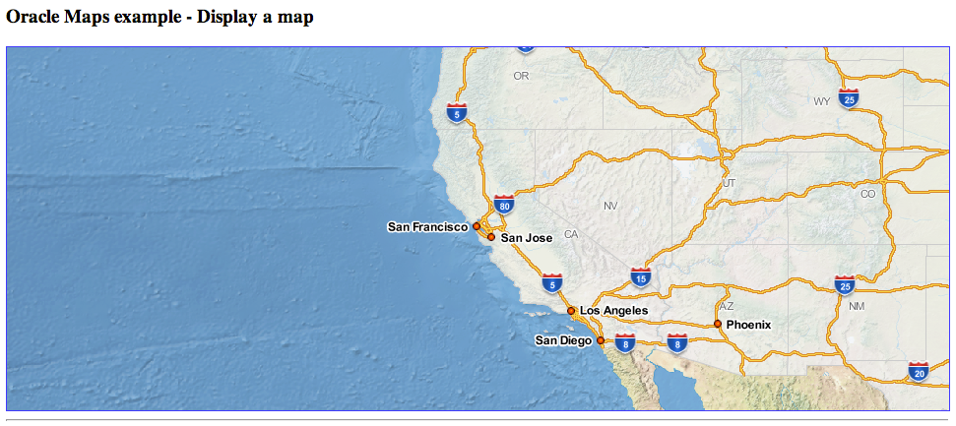
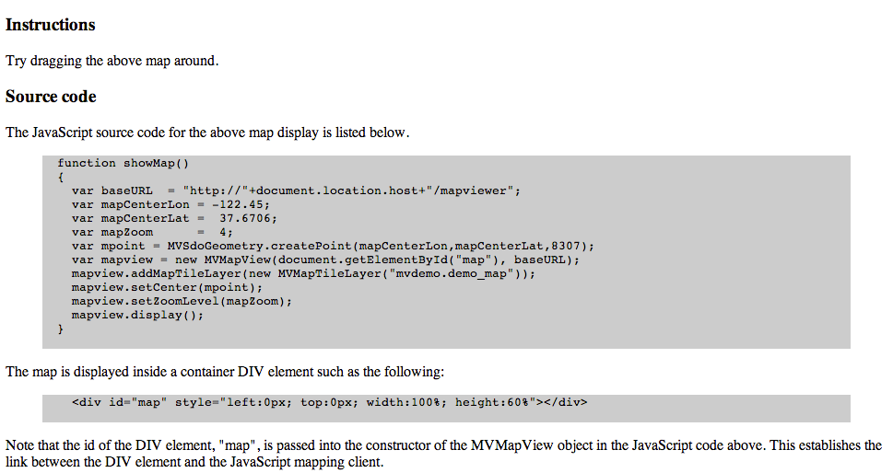
Oracle Maps V1 Tutorials
Run and test the example
Examine the source code

Slide 38
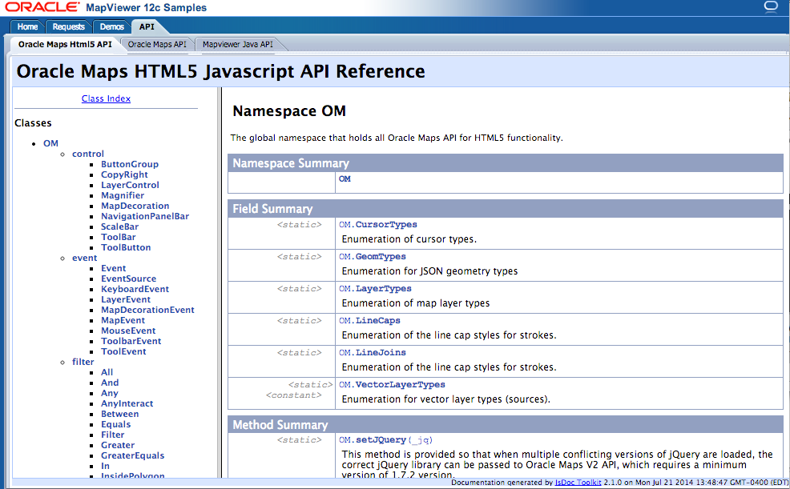
Oracle Maps V2 API Documentation

Slide 39
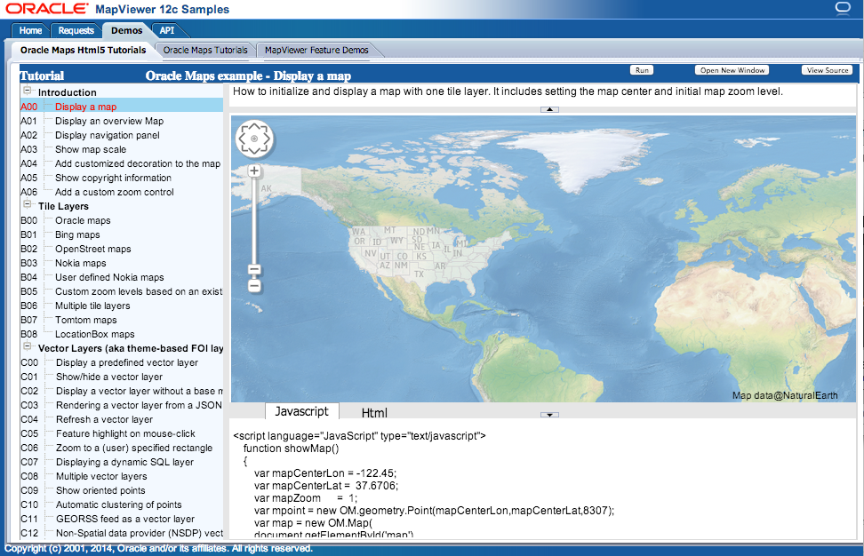
Oracle Maps V2 Tutorials
Run and test the example
Examine and modify the source code

Slide 40


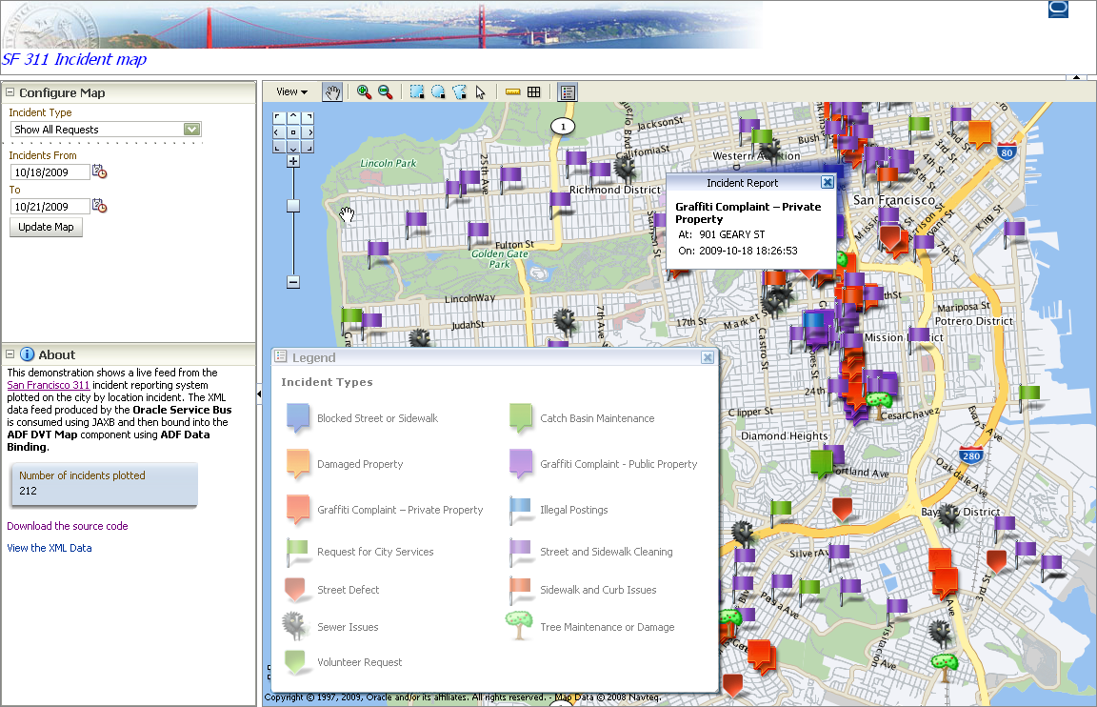
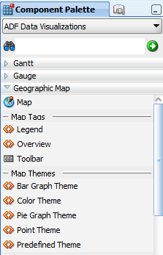
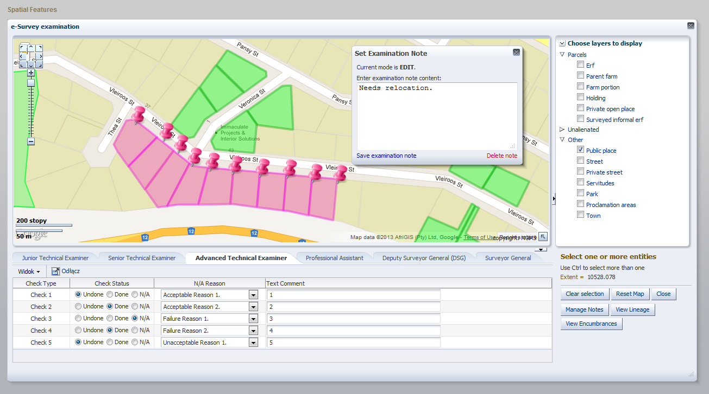
Application Development
Java ADF Faces - JDeveloper
<dvt:map> Component

Slide 41
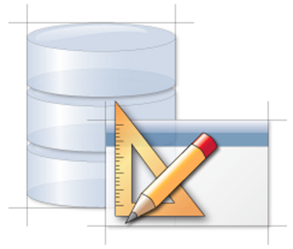

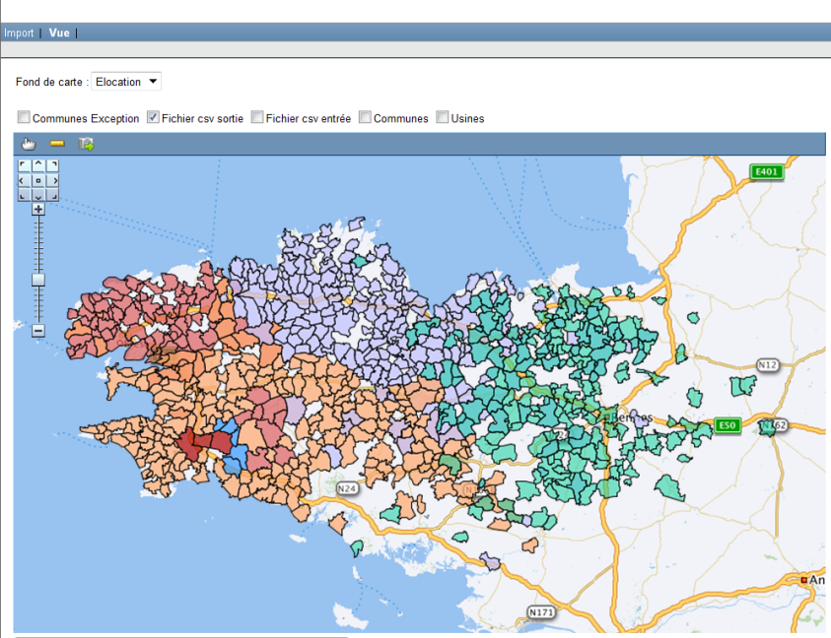
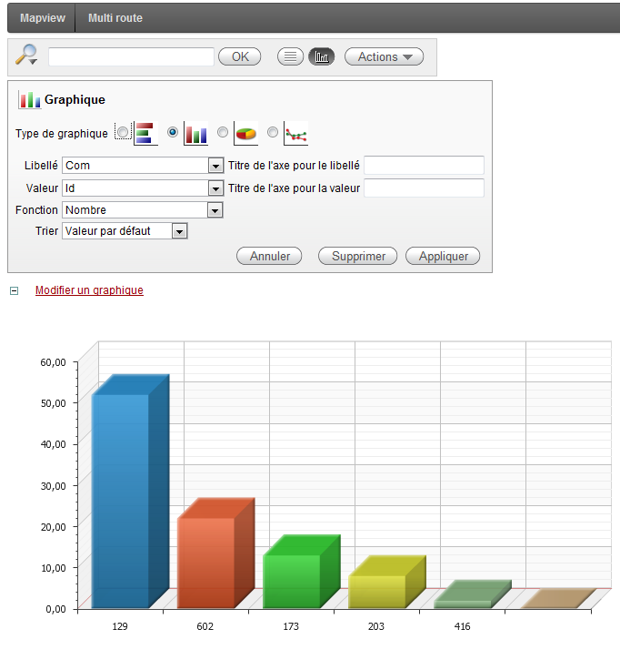
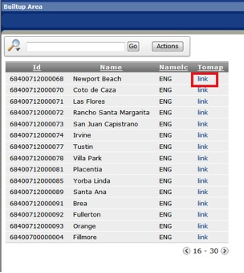
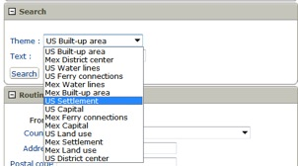
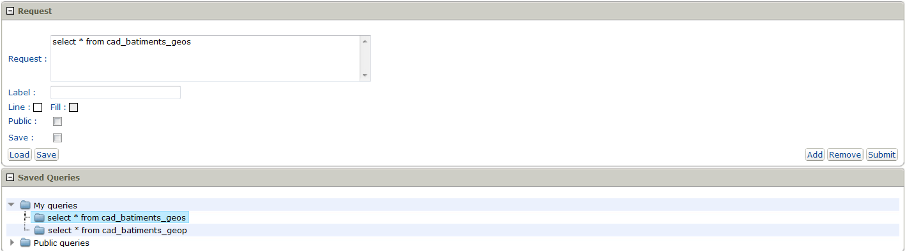
Application Development
Application Express

Slide 42
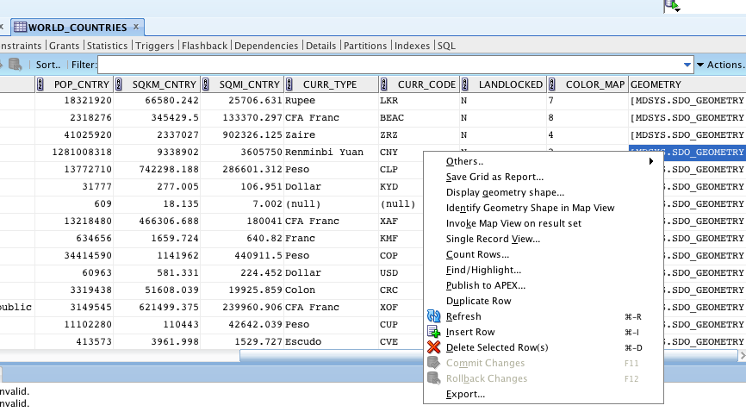
SQL Developer and Map Views

Slide 43


Slide 44



SQL Developer – Data Maintenance

Slide 45
Data Editor
Web-based spatial data editing tool
Supports versioned, concurrent editing through editing “sessions”.
Supports geometry model
Future: topology-based editing.
Supports WFS-T
Editing sessions are saved in database
Admin tool to visually review editing sessions, and resolve conflicts.

Slide 46
Integrating External Data Sources
Oracle eLocation
Application
Google Maps
Microsoft Bing Maps
JavaScript Map API
Custom Tile Servers
HTTP
Tile Cache
Tile Cache Server
Data Server
Map Rendering Engine
JDBC
WMS
WFS
Spatial
Tables
Map
Definitions
Mapbuilder

Slide 47
Integrating External Data Sources
Consuming and aggregating third party spatial data sources
eLocation, Bing, Google
Any other map tile server (via a custom adapter)
Support many standards:
WMTS (Tile Service),
WFS, WMS,
Geo-Json, GeoRSS.
Bundles GDAL/OGR for support of even more external data sources

Slide 48

Location Intelligence
Combining the power of Business Intelligence and Maps

Slide 49

Advanced Spatial Analytics

Slide 50

Mobile Devices
Full support for mobile devices (tablets, smartphones)
Tablet gestures (zoom, pan, identify, draw)
Landscape vs portrait orientation.

Slide 51

MapViewer in Action
Oracle eLocation Services
http://maps.oracle.com

Slide 52

More Information … http://www.oracle.com/technetwork/middleware/mapviewer

